Slide 1
Finalizing a Model
Translate Results into Business Actions
Incorporate a Model into a Long-Term Business Solution

Slide 2

Translate Results into Business Actions

Slide 3

Know Your Audience
Your audience might be:
Just you, no reporting needed
A single person
A small group of stakeholders
An entire organization
You may need to adjust your reporting for:
Different knowledge
Different needs
Different expectations

Slide 4
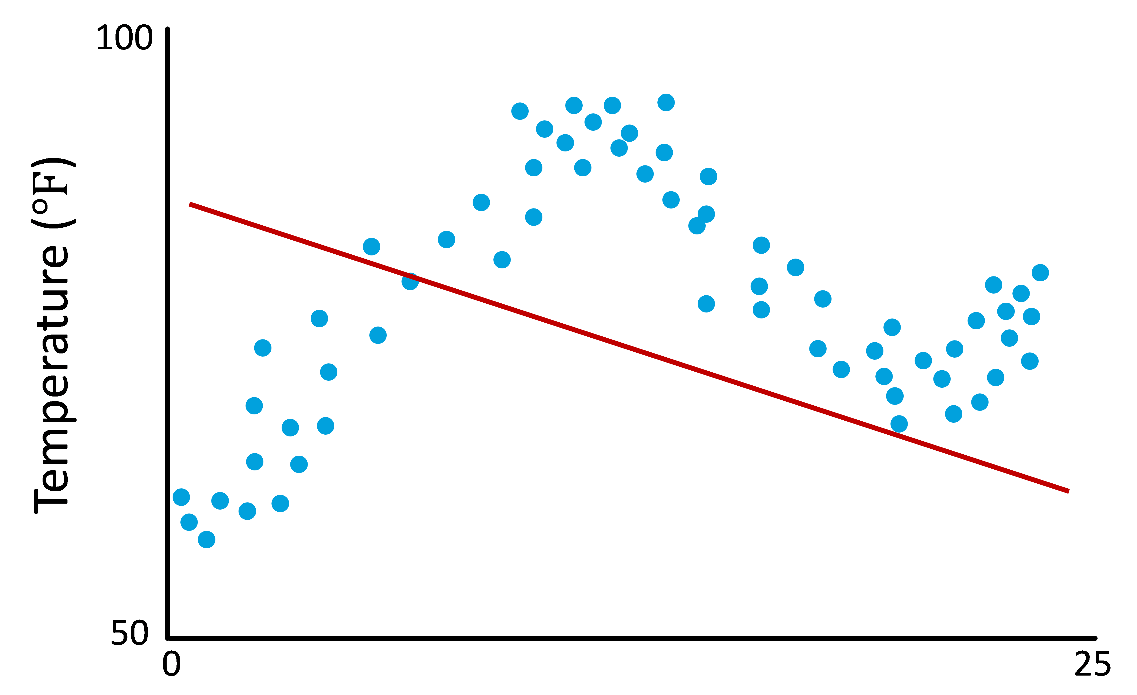

Visualization for Presentation
You’ve used visualizations throughout the project for data analysis, training, and testing the model.
Visualizations provide a powerful means to convey patterns in numbers.
Consider using them to help your audience understand the results produced by your machine learning model.

Slide 5

Put Together a Machine Learning Presentation
An executive summary or abstract of the project
The business problem you set about to solve
The data
The hypothesis
The solution

Slide 6
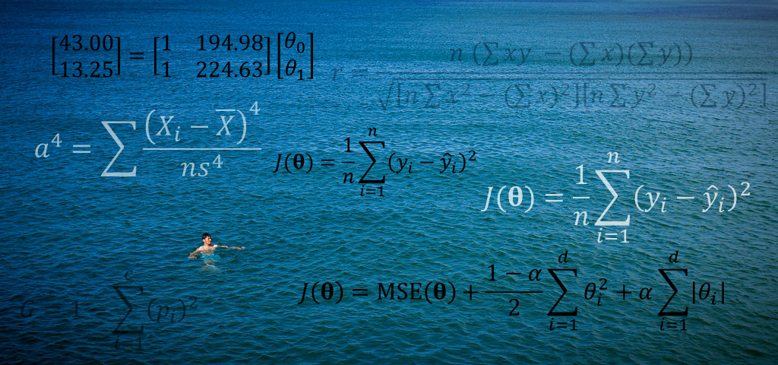
Communicate Your Findings Clearly
Don't drown your audience in a sea of numbers.
Use visuals strategically.
Use formatting, labels, and legends.
Avoid suspense.
Provide context for details.
Be honest and transparent.
Identify key assumptions you have made.
Check your work.
Invite feedback.
Provide supplementary communication channels for those with different communication styles.
Provide supplementary documentation for those with different informational needs.
Test it before you deliver it.

Slide 7
Use Visualization Tools to Present Your Findings
Label axes and chart titles with meaningful names.
Use legends as needed to identify what values are shown in a chart.
Don’t rely solely on color coding, but when you must use it, use color palettes that can be detected by people with color blindness.
Avoid adding unnecessary details or decoration that hinder readability, such as backgrounds or themes.

Slide 8

Activity: Translating Results into Business Actions
You are developing a real estate pricing model.
Your findings debunk the idea that location is the single most important factor.
The strongest predictors are the size of the home and its grade.
There is some correlation between house prices and neighborhoods.
View and waterfront don't matter as much as house size and building quality.
Your new model runs contrary to pricing principles agents have used for years.
As you head into a presentation to sell them on using your model, you're concerned that there may be some resistance to adopting it.
How can you present your findings to the real estate board so they not only understand how your pricing model is different from what they've done in the past, but so they are also convinced they should use it?
The model is complex and subtle in its calculations. In the past, agents have used a simple paper worksheet to calculate a listing price, but the new model is too complex for that. How might you make it easy for agents to get pricing for a house based on the new model?

Slide 9
Incorporate a Model into a Long-Term Business Solution

Slide 10


Put a Model into Production
Some machine learning models:
May not simply result in a one-time recommendation or answer
May instead be a prototype for a new capability you will roll into:
The organization's website
A mobile app
Enterprise applications
In this case, you may need to:
Deploy the algorithm on a different software platform
Hand your prototype off to software developers for further development, testing, and maintenance over time
MACHINE LEARNING
CONDENSED
TECHNOLOGY
Enterprise Applications

Slide 11
Production Algorithms
Machine learning software libraries commonly used for research or prototyping may not be optimized for production implementations.
Cloud services that don't use the same environment you used for your proof of concept
Support for multiple threads, multiple users
Support for other hardware, such as GPUs instead of CPUs
You may need to consider your initial work to be a prototype and be open to using more appropriate tools for production use.
Training and optimization workflow must be repeated when using a different implementation of an ML algorithm.
Prototype nonetheless will help to understand the problem and the expected outcomes.

Slide 12
Pipeline Automation
Collect
Aggregate & Clean
Incorporate Into Models
Deploy
Functions by enabling data wrangling tasks to be chained together in series.
Supported by tools such as scikit-learn Pipeline utility.
Reduces tedium, saves time, and ensures process is done the same way each time.
Prevents errors such as leaking training data into the test set and missing data cleanup or transformation steps.
Improvements to workflow are written into automation scripts to ensure they'll be performed.
ML models used for ongoing, repeated business processes or applications should have an automated data pipeline.

Slide 13
Testing and Maintenance
CACE principle—changing anything changes everything.
Concept drift
May happen subtly, with insignificant changes from one batch of data to the next.
Over time, changes may be significant.
May reduce the model's ability to perform effectively.
Changes in software
Third-party software libraries are used for data pipelines and machine learning algorithms.
When libraries are updated, they may change the model's performance.
It may be necessary to periodically retrain the model and test it to ensure the model still performs as required.
Aspects of this can be automated.
Automated monitoring and testing tools to track the model's performance over time and raise alarms if skill drops below a minimum level.
Some models can be configured for online learning, updating themselves periodically.
When setting up self-updating models, consider using a separate "staged" environment, pushing the model out to production only after you have thoroughly verified it.

Slide 14

Consumer-Oriented Applications
Machine learning APIs
Application programming interfaces
Are provided for Android, iOS, Windows, Linux, and numerous other operating systems
Enable applications to perform a wide range of AI/ML tasks
Text recognition, face detection, barcode scanning, image labeling, object detection and tracking, landmark recognition, language identification and translation, smart message replies and typing suggestions, and so forth.
May use the device's network connection to offload heavy processing tasks to cloud services
May be performed directly on the device, in real time

Slide 15


Maintain Models Incorporated into Applications
Create software unit tests that validate the data model every time new code is pushed out to the application.
Protect the model from upstream changes to the data pipeline.
Protect downstream consumers of the model.
Design for periodic retraining of the model.
Provide a versioning system for various machine learning components used in the application.
Put appropriate protections in place for the data pipeline and all outputs.

Slide 16


Activity: Incorporating a Model into a Long-Term Solution
You are working with the CapitalR Real Estate company to:
Incorporate a pricing calculator into a web-based application based on the machine learning model you prototyped.
You will:
Guide the web developers on issues related to machine learning.
Help to write software requirements and test cases.
Custom Application
Real Estate Pricing Calculator
Questions:
What market factors might affect the real estate pricing model, and how frequently should the model be updated to account for them?
What software requirements might you include to ensure the pricing calculator remains accurate, considering the various market factors you identified in the previous question?

Slide 17
In your machine learning projects, to whom will you typically have to present your findings, if anyone?
Where do you see your machine learning models being deployed, and how will this affect your maintenance of the model?

